Slide 1
Research Article
Machine Learning and IoT-Based Waste Management
Authors: Rijwan Khan, Santosh Kumar, Akhilesh Kumar Srivastava, Niharika Dhingra, Mahima Gupta, Neha Bhati, and Pallavi Kumari
Hindawi Computational Intelligence and Neuroscience
Volume 2021, Article ID 5942574, https://doi.org/10.1155/2021/5942574
Presented By:
Shaikh Md. Shahidul Islam - M240105052
Kazi Muhammad Afsarul Hoque - M240105078
Md Arifur Rahman - M240105042
Presented To:
Dr. Sajeeb Saha
Associate Professor
Dept. of Computer Science and Engineering
Jagannath University

Slide 2
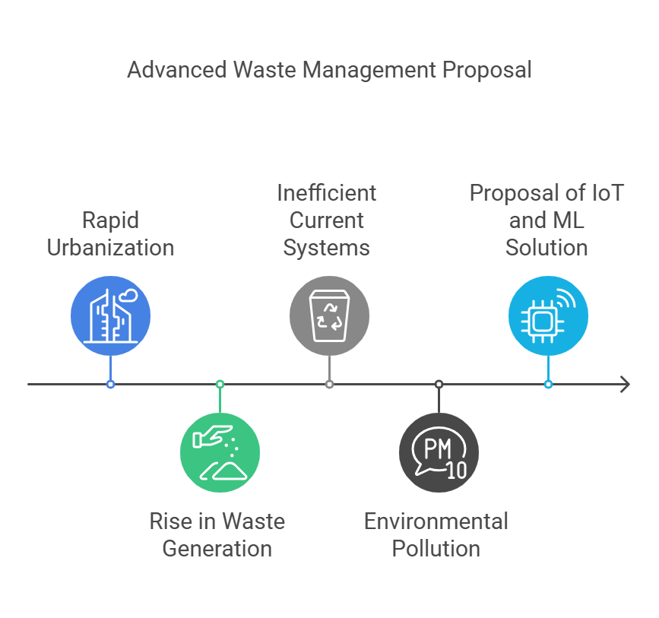
Introduction to Smart Waste Management

Slide 3




Key Challenges
Improper scheduling and collection methods
Lack of real-time data for waste levels
Inefficient classification of municipal waste
Limited public-private collaboration for sustainable solutions

Slide 4
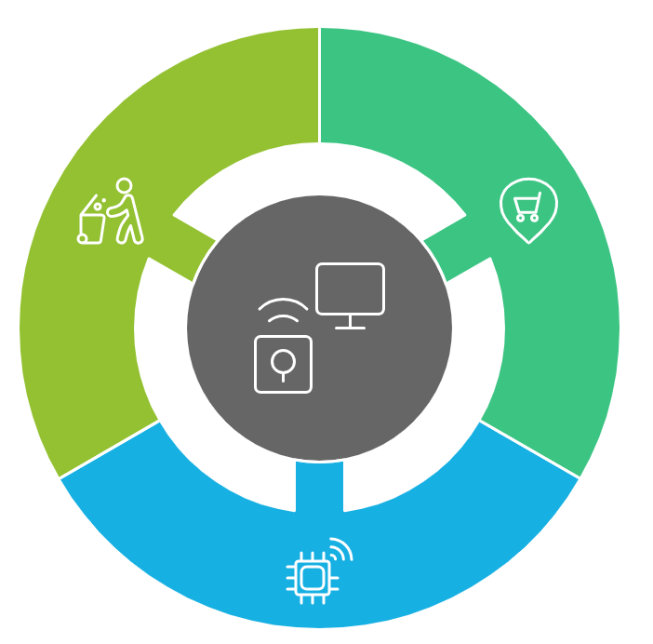
Objectives of the Study
Real-time monitoring of waste levels in bins and dumping grounds
Optimization of collection routes to save time and fuel
Implementation of IoT and ML for efficient waste categorization and disposal

Slide 5
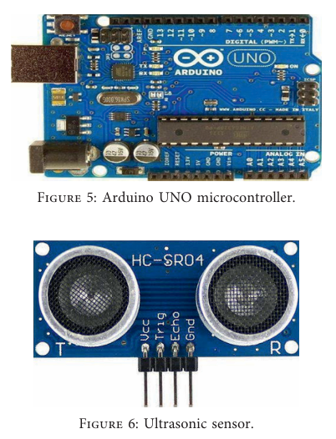
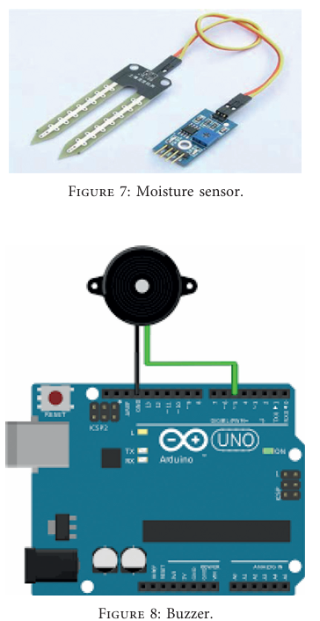
System Components and Architecture
Hardware:
Arduino UNO microcontroller
Ultrasonic and moisture sensors
Supporting components: LEDs, buzzers, jumper wires
Software:
Mobile app for real-time tracking and route optimization
Image processing for waste index calculation

Slide 6
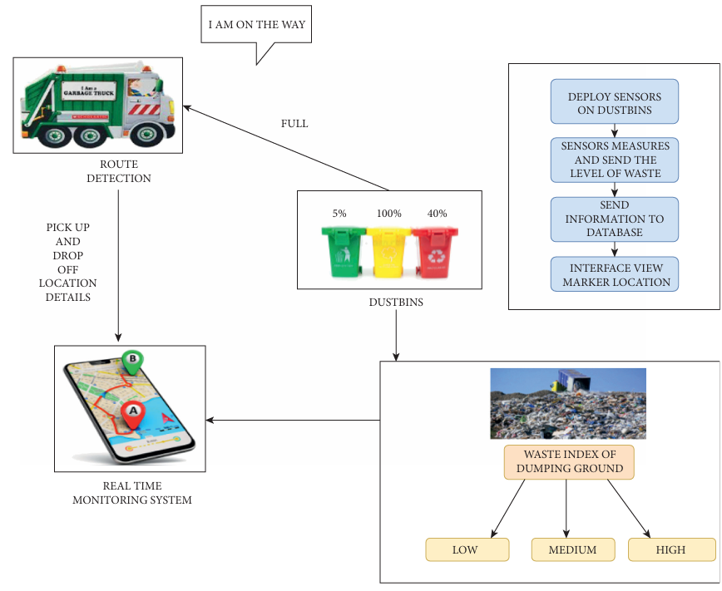
Flow of Operations
Sensors detect waste levels in bins and classify them as dry or wet.
Data is sent to a central system for analysis via IoT.
Mobile app prioritizes bins based on waste levels and guides trucks.
Trucks follow optimized routes for collection.
Waste is transported and processed efficiently.

Slide 7
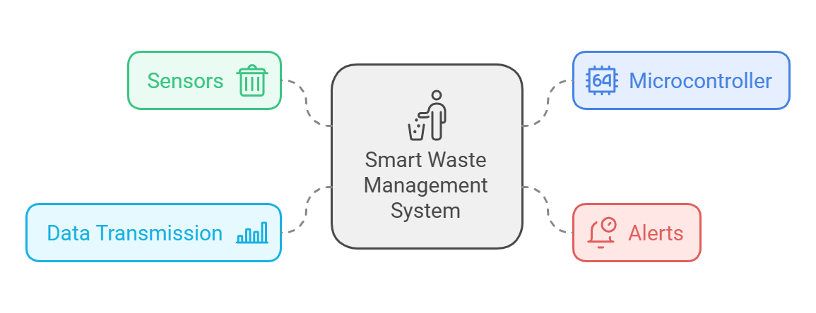
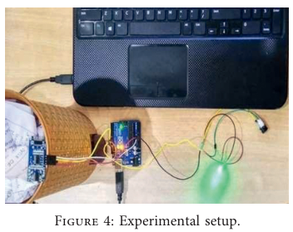
Experimental Setup
Ultrasonic sensors measure the distance to waste in bins.
Moisture sensors classify waste as dry or wet.
Arduino UNO microcontroller processes sensor data.
A buzzer and LED provide real-time alerts when bins are full.
Data is transmitted to a database for further analysis.

Slide 8

Proposed System Architecture
Sensors capture waste levels.
Arduino UNO processes the data.
IoT framework sends real-time updates.
Mobile app tracks bins and provides optimized routes.
System prioritizes high-waste bins for collection.

Slide 9
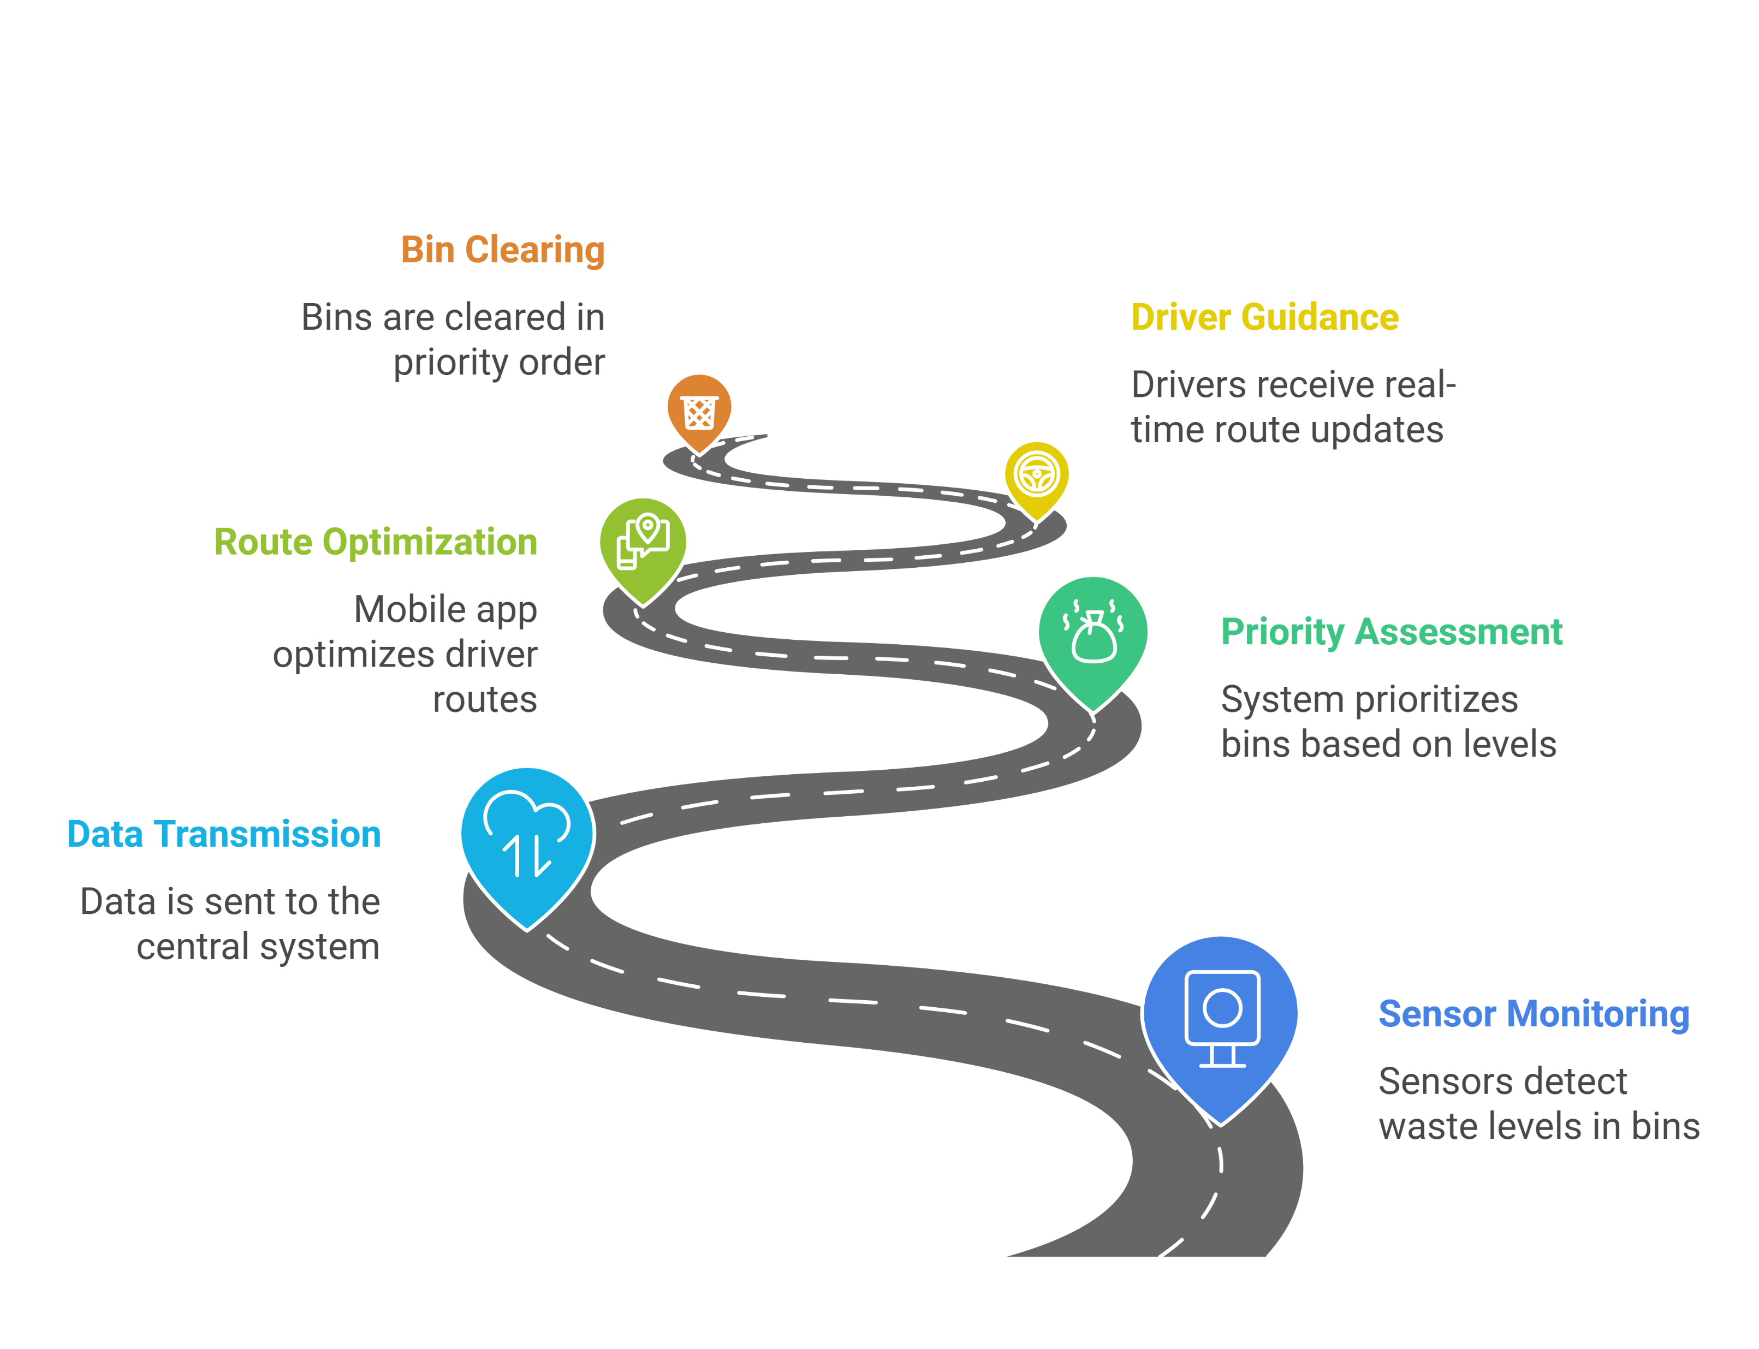
Real-Time Monitoring System

Slide 10
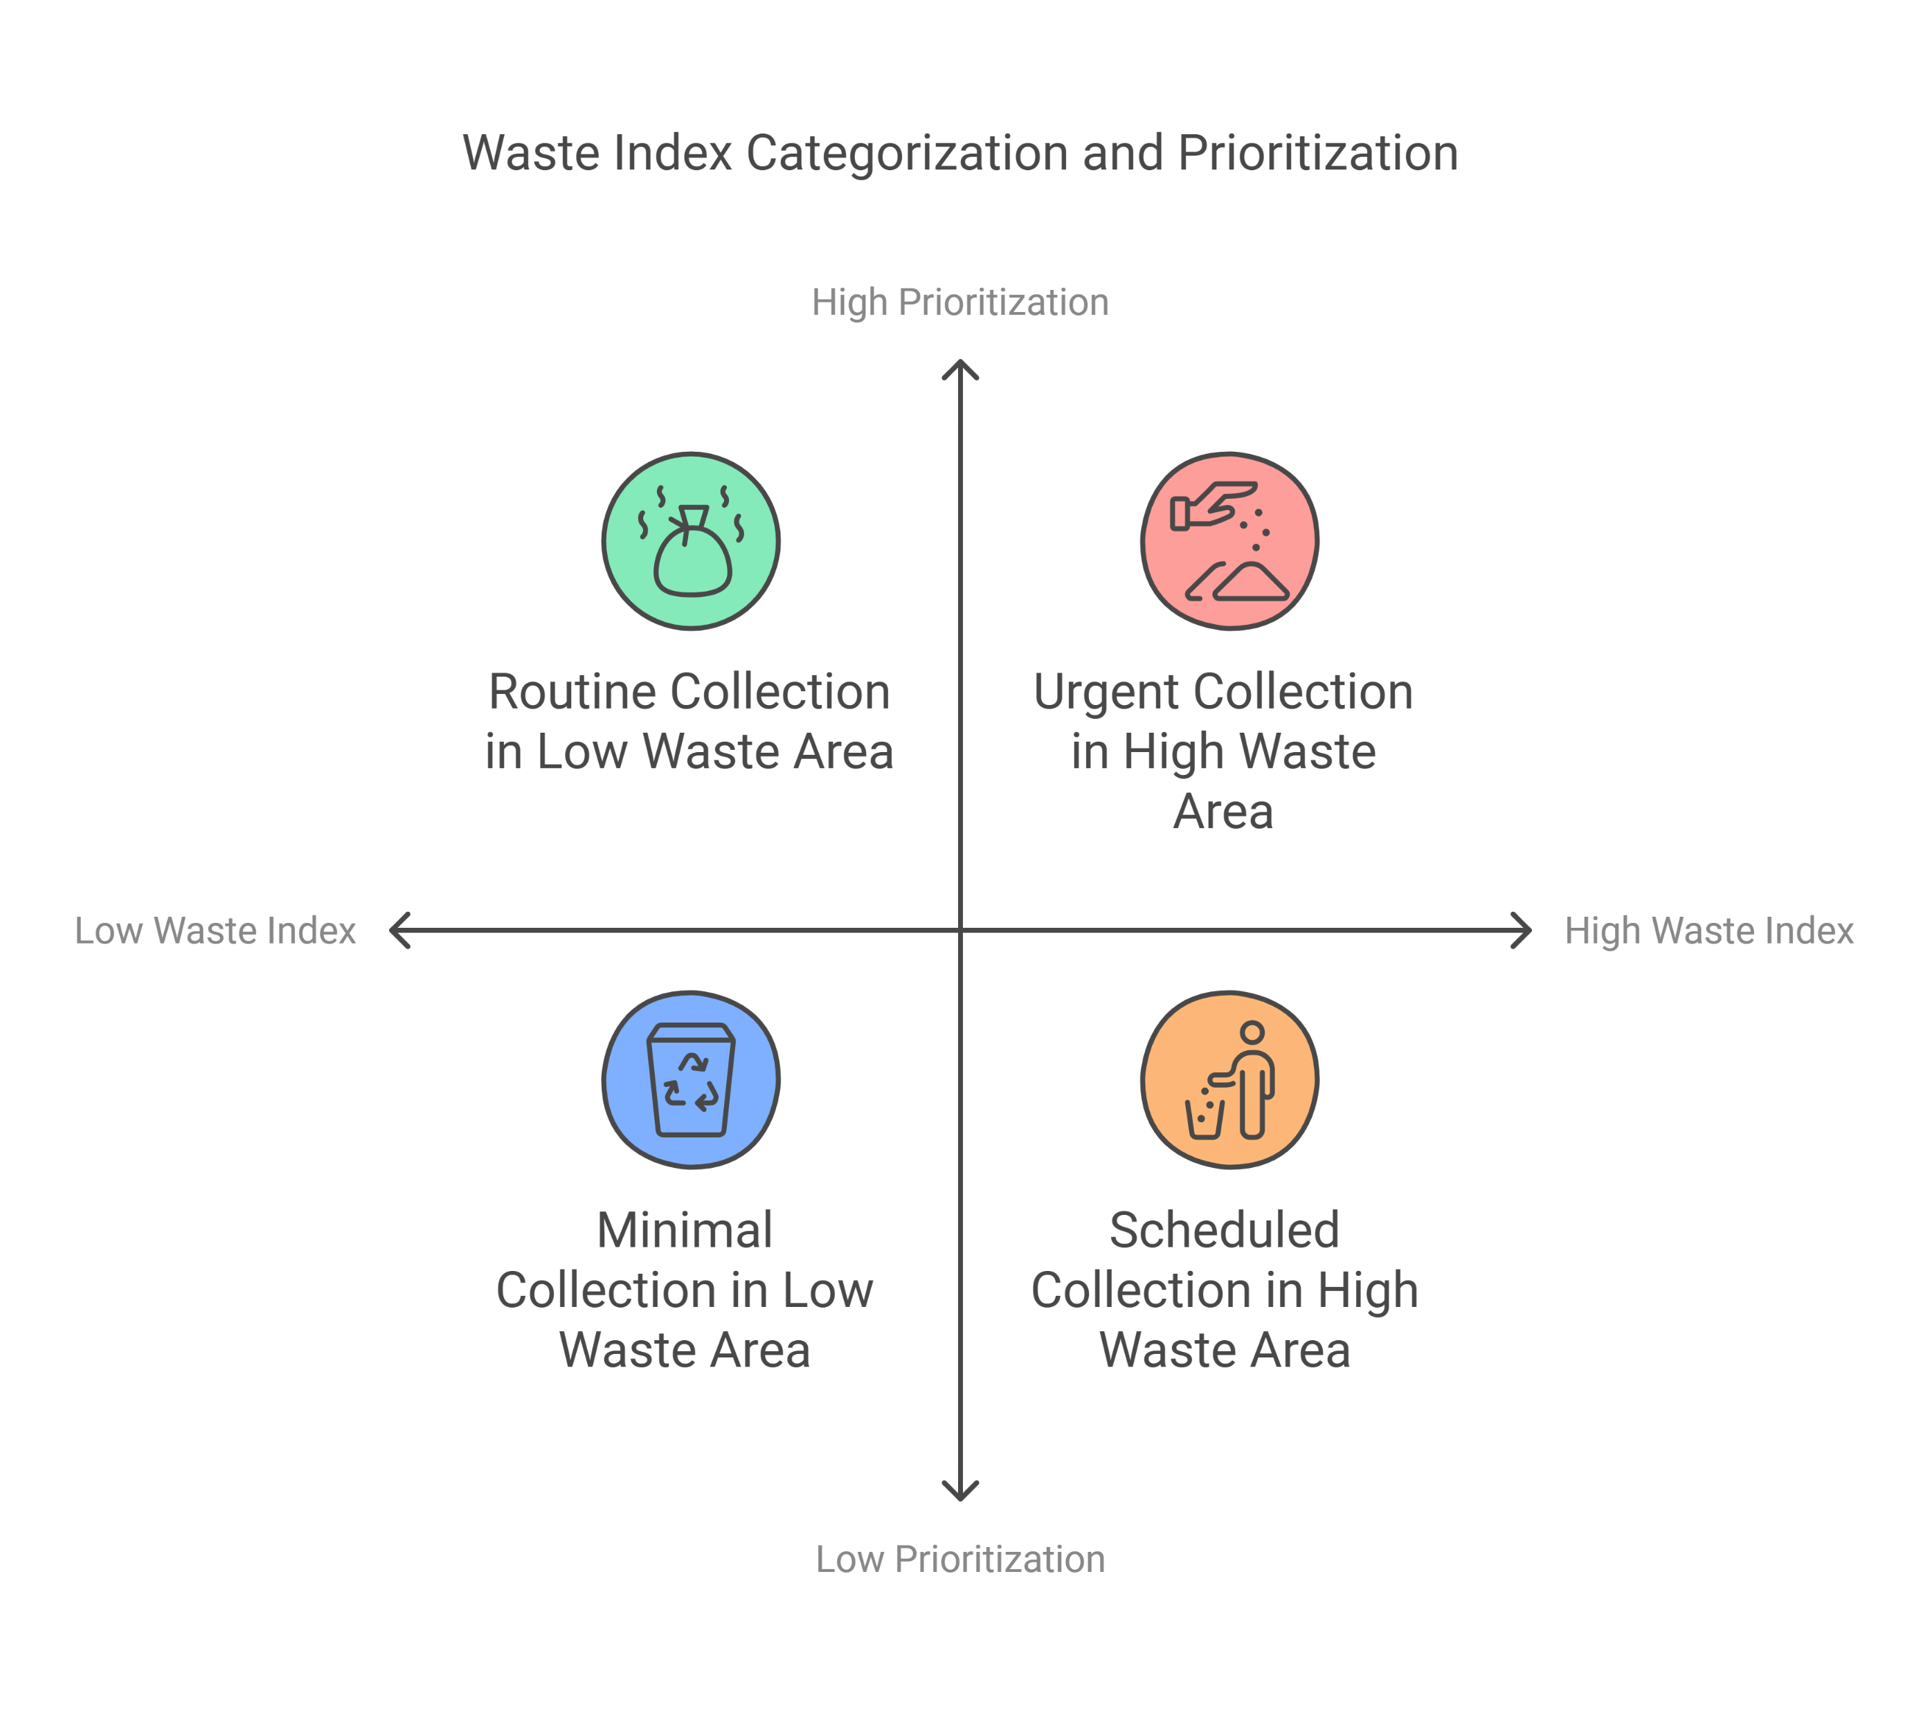
Image Processing for Waste Index
Image processing techniques calculate the waste index of dumping grounds.
Index categories: Low, Medium, High
Prioritization based on waste index optimizes collection schedules.

Slide 11
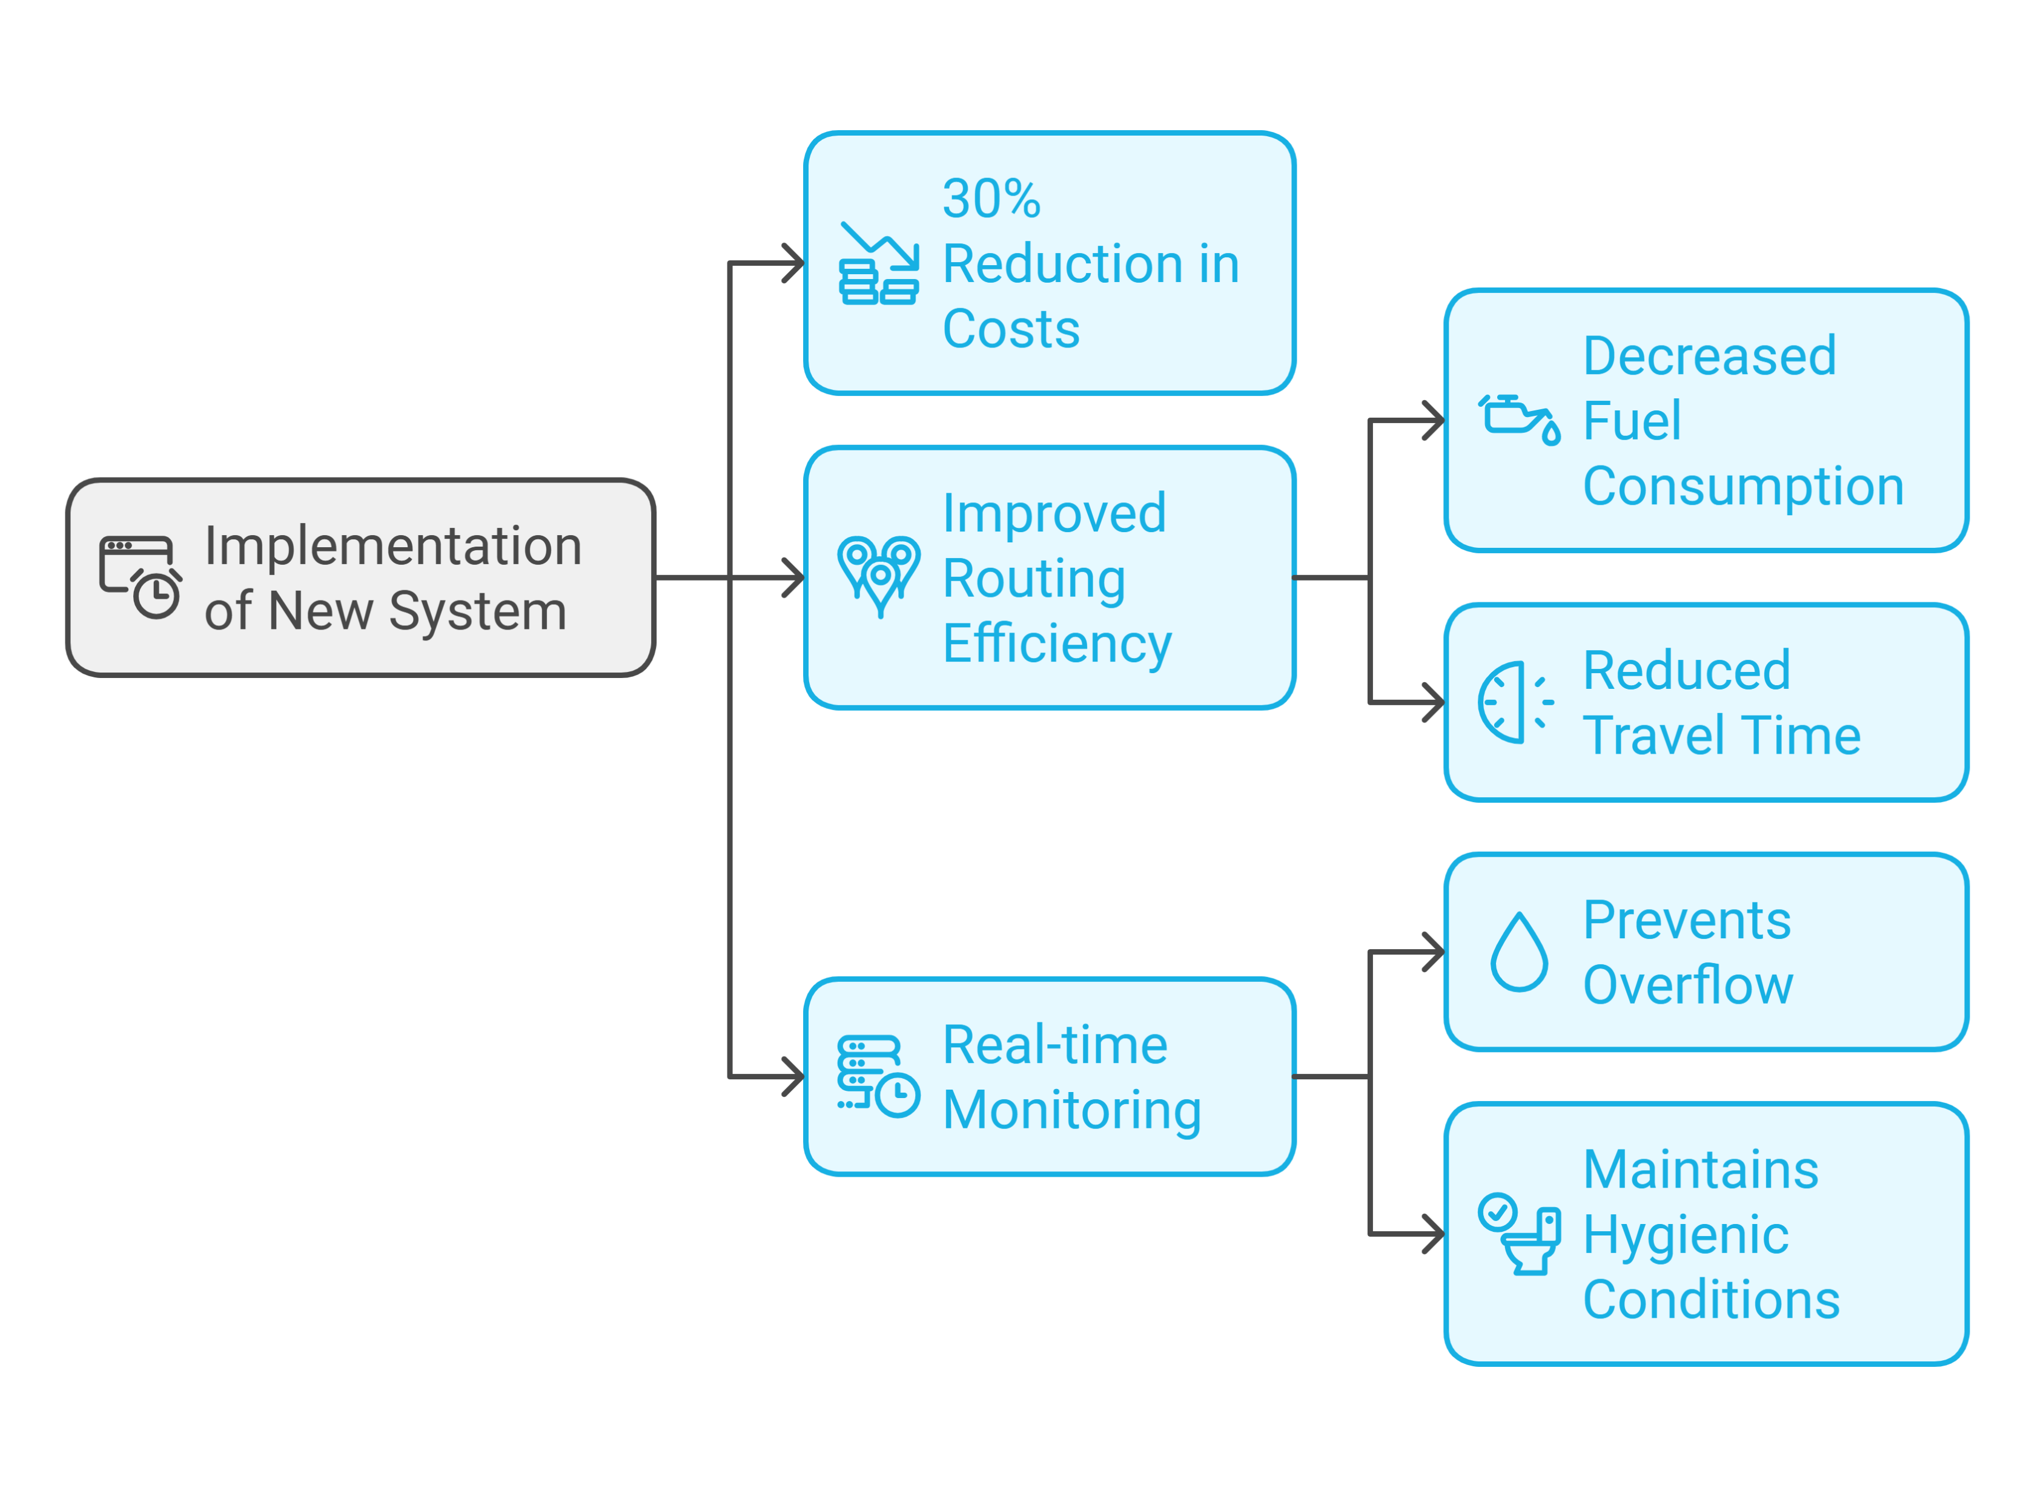
Results and Performance Analysis
Infrastructure and maintenance costs reduced by 30%.
Improved routing reduces fuel consumption and time.
Real-time monitoring prevents overflow and ensures hygienic conditions.

Slide 12
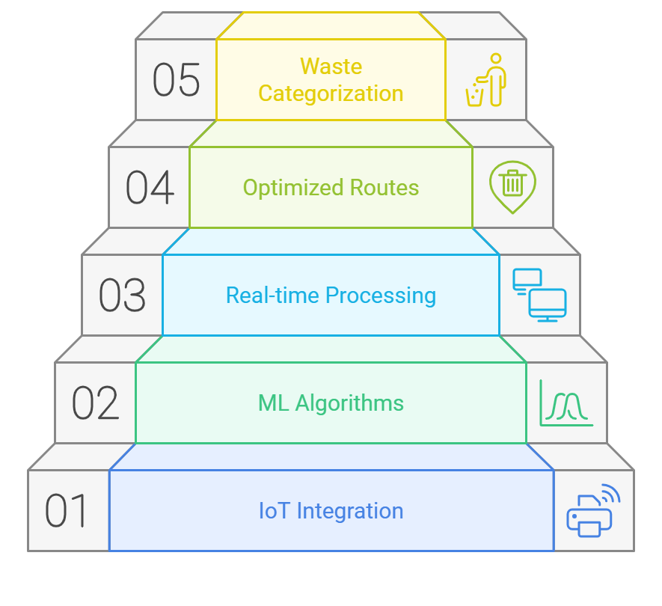
Proposed Model
IoT and ML integration
Real-time data processing
Optimized routes
Waste categorization

Slide 13
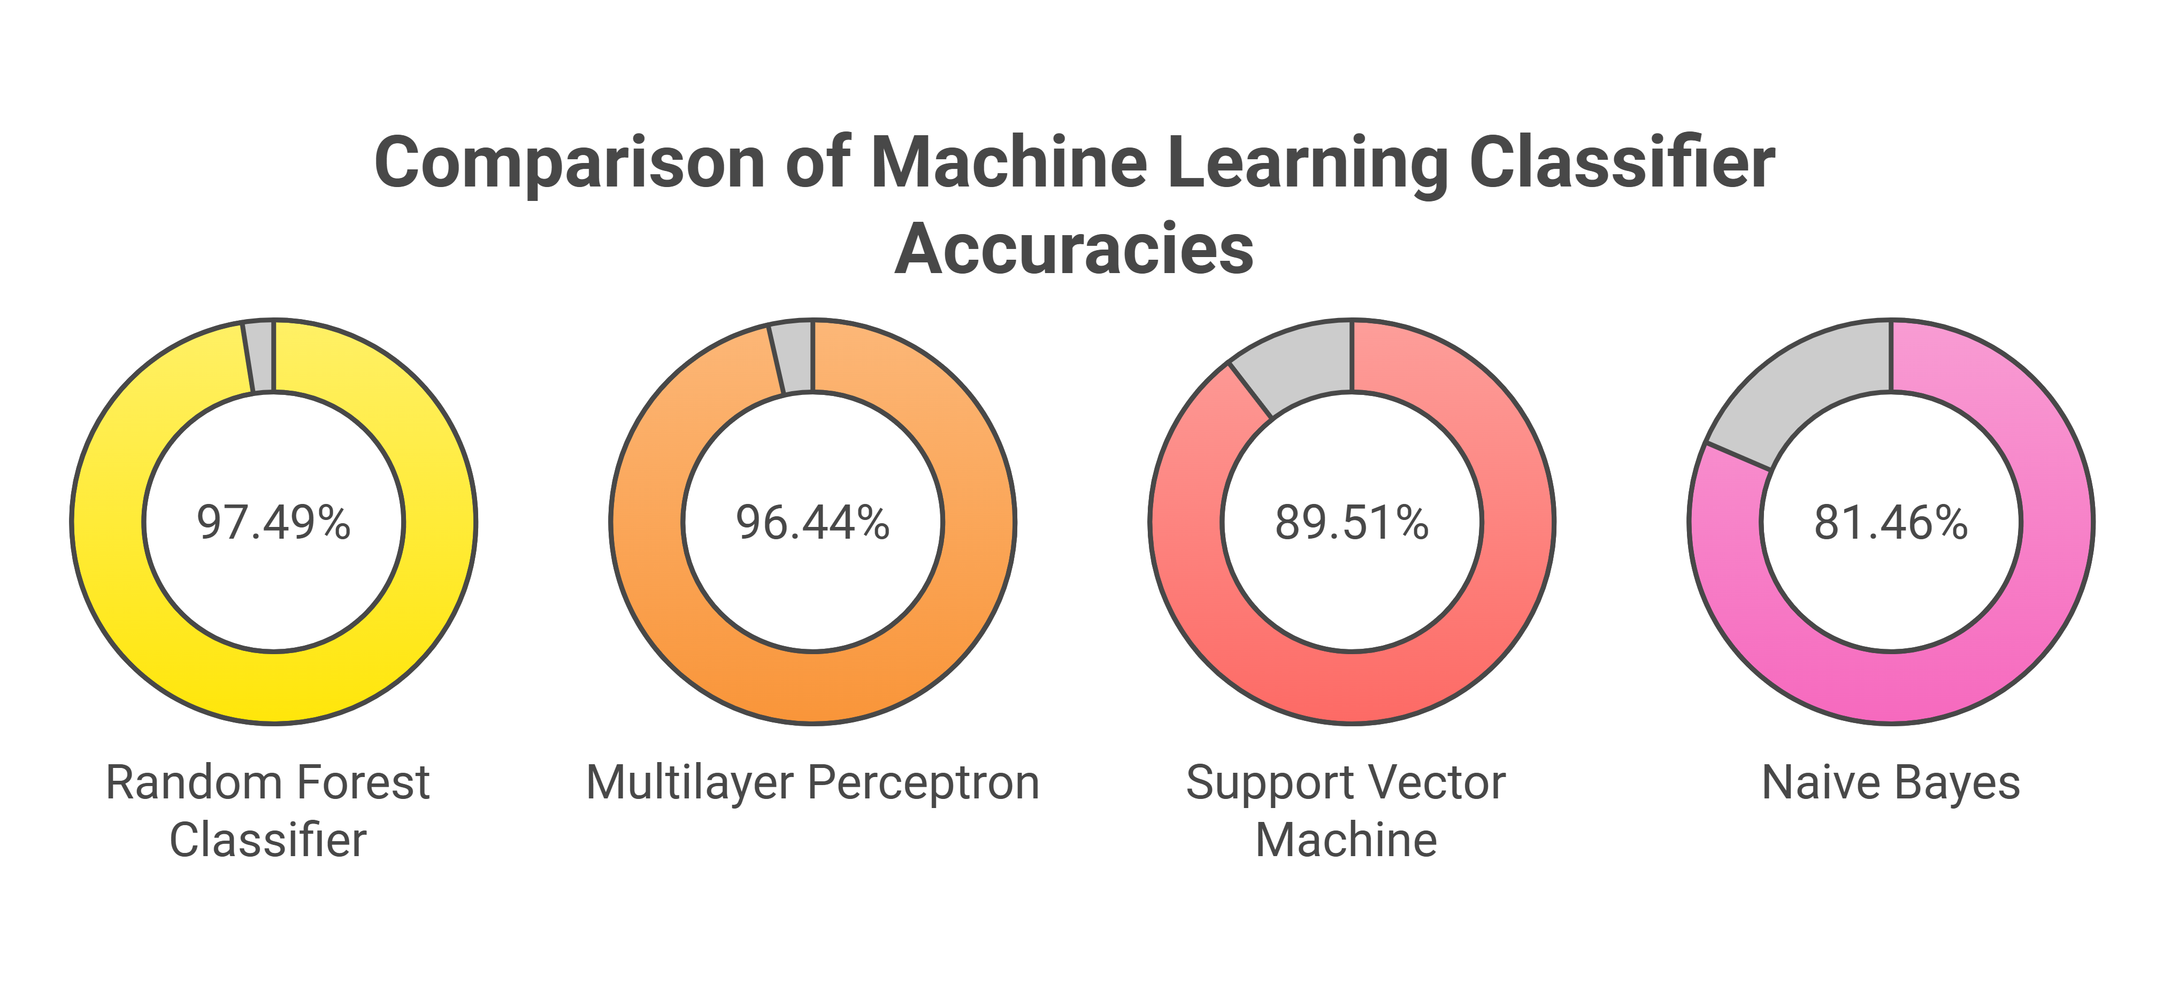

Slide 14
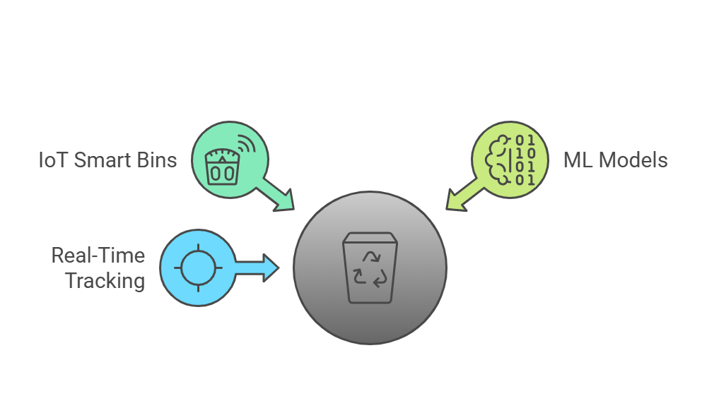
Key Findings
IoT-based smart bins significantly improve waste collection efficiency.
ML models provide accurate waste categorization.
Real-time tracking and routing reduce environmental impact and costs.

Slide 15
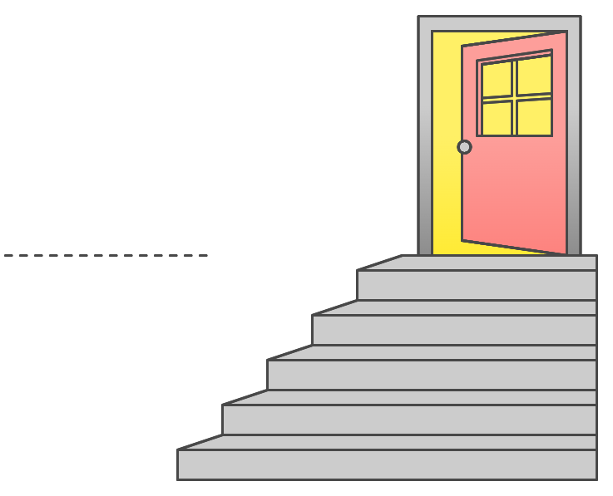
Future Work
Expand system for hazardous and liquid waste.
Enhance ML models for more accurate categorization.
Broaden implementation to include rural areas.
Integrate advanced IoT protocols for better scalability.

Slide 16
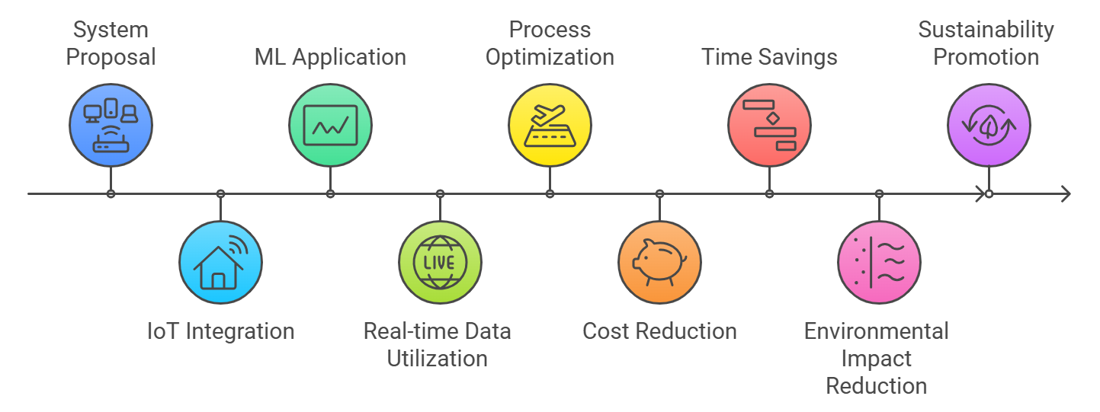
Conclusions

